Slide 1
Automating Software Installs with PowerShell (and a little ConfigMgr)
>_
#!
Presented by:
Adam the Automator

Slide 2

PS> Whoami
Pluralsight Author
PowerShell Trainer
Freelance Writer
PowerShell Consultant
Blog: adamtheautomator.com
Twitter: @adbertram
Cloud/Datacenter Management MVP

Slide 3

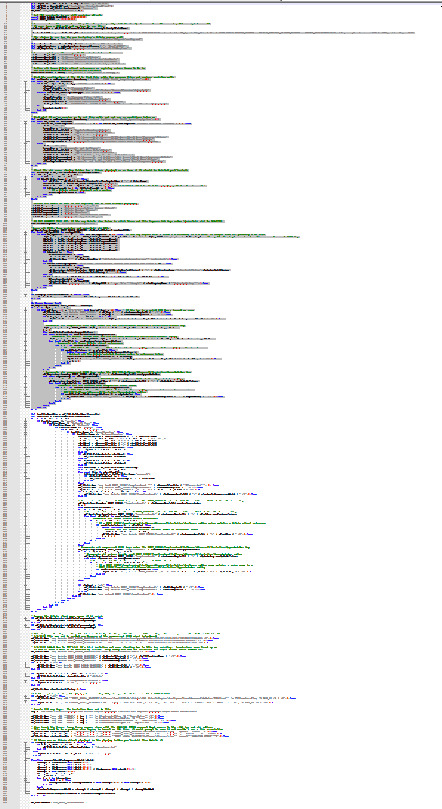
The 100 Hour Week
What on earth would require 100 hours in a week?
It rhymes with “itrix”
Lots of config differences
Helpdesk calls (My icon!)
Finance is down!
Kill me now!
Sleep
Boss: WTF? Me: Yep
Notes:
Anyone worked 100 hours in a week? …was it what you’d consider fun?
Application that rhymes with itrix that needed upgraded enterprise-wide from 12.4 to 13.
This app required different configurations whether it was a thin client, x86/x64, desktop, etc.
Citrix admin comes up to me on Friday..
Used the methodology for an old version and thought it’d work for the new version.
Pushed out to group on Monday evening..minor problems…fixed.
- Tested checking if in ARP and a single Citrix application..worked
Helpdesk calls about icon that’s changed the next day
Pushed out again on Tuesday evening..minor problems..fixed
Finance calls in a panic on Wednesday morning that their application won’t run.
- we didn’t test that application. It required another registry key to enable single sign on
The week continues like this until I eventually accumulated 100 hours
I was a consultant at the time for this client and my boss emailed me and said “did you make a typo on your timesheet”?
This could have been prevented if the versions didn’t change so much.

Slide 4
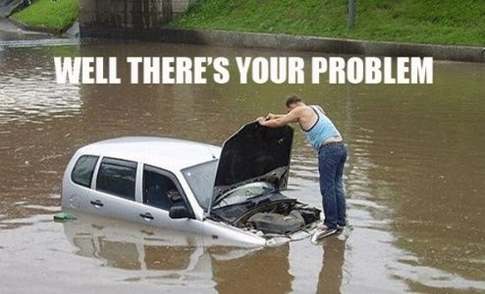
Well, There's Your Problem
Lack of Package Standardization
Hard to define “installed” and “uninstalled”
Post-install configuration needed
Cleanup work post-uninstall

Slide 5
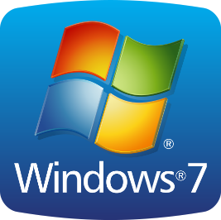
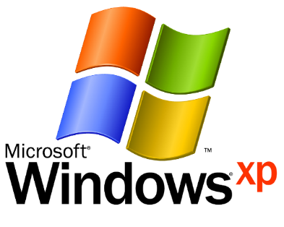
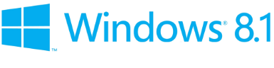
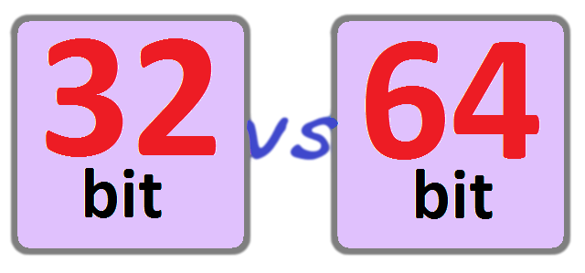
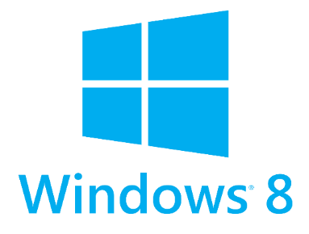
Is this Your Environment?
Notes:
Does this look like your environment?
Who here has all Windows 8.1 and Server 2012 R2 only? …..are you hiring?
Each OS and architecture is different and needs to be accounted for.

Slide 6
The Solution: Treat all Software Equally
Build a management framework in PowerShell
Pull all decision-making into PowerShell
Use ConfigMgr for delivery, execution and detection and reporting only (ConfigMgr not even necessary!)

Slide 7
Solution: Tactical Steps
Build functions for routine tasks
Script at an abstracted level
Install-Software instead of msiexec.exe or setup.exe
Abstract away the operating ystem
C:\Users or C:\Documents and Settings becomes Get-UserProfilePath
All ConfigMgr applications become:
Install.ps1
Uninstall.ps1
Detect.ps1

Slide 8
SoftwareInstallManager PowerShell Module
A grouping of dozens of common functions
Built from blood, sweat and tears. You’re welcome!
Imported before each install, uninstall and software detection step
Called from a UNC share but doesn’t have to
http://www.github.com/adbertram/SoftwareInstallManager

Slide 9
Demo Environment
ConfigMgr 2012 R2
PowerShell execution policy: Unrestricted
PowerShell v4 on clients
Windows 8.1 (CLIENT1)
Windows 7 (CLIENT2)
MEMBERSRV1 hosting PowerShell module

Slide 10
Your Job is Never Done
This isn’t perfect – Help make it better!
Use this as a starting point and incrementally add to it
Where else can this be used?

Slide 11
Thanks!
Blog: adamtheautomator.com
Twitter: @adbertram
Scripts: http://bit.ly/mnscug

